Slide 1
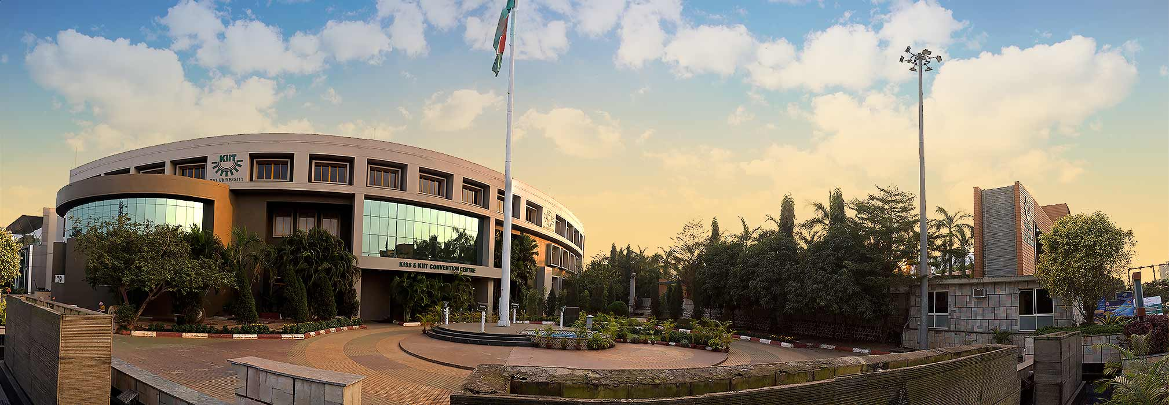
Plant Leaf Disease Prediction Using CNN
Submitted in partial fulfillment of the requirements for the degree of B.Tech In
Computer Science and Engineering
By
RUCHIKA KATYAYANI 1805598
NIKHIL KUMAR UPADHYAY 1805676
Under the guidance of
Professor Chandini Kumari
School of Computer Engineering
KALINGA INSTITUTE OF INDUSTRIAL TECHNOLOGY
(Deemed to be University)
BHUBANESWAR

Slide 2
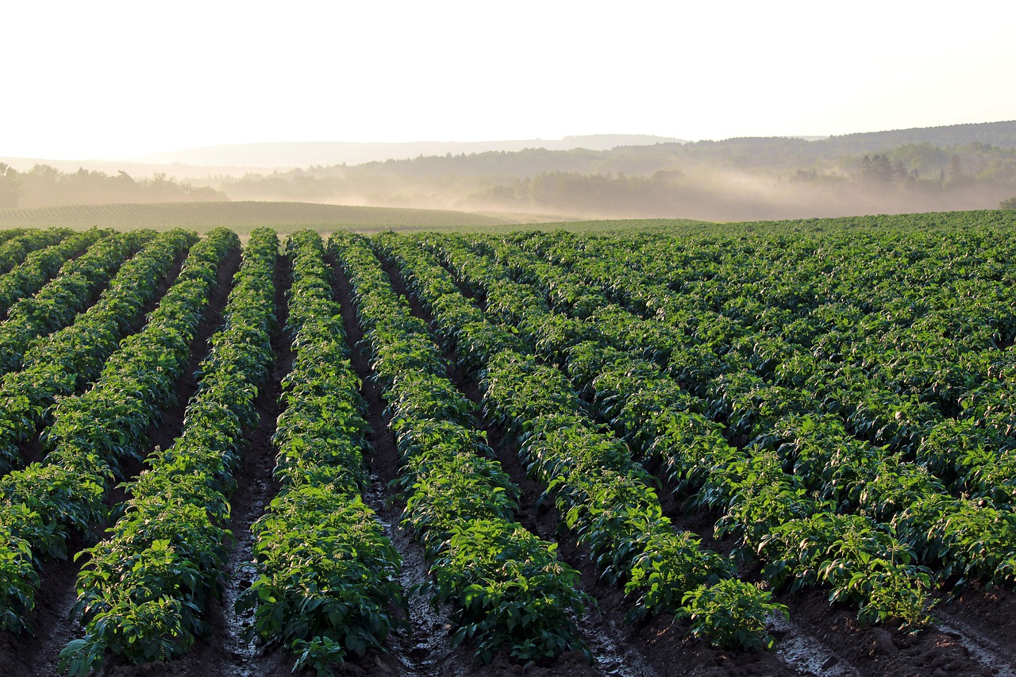
INTRODUCTION
Currently , we have trained our model for 3 plants:
Potato
Tomato
Pepper
Our model an identify the following diseases in respective crops:
Potatoes :
Early Blight
Late Blight
Pepper:
Bacterial Spot
Tomatoes :
Bacterial Spot
Early Blight
Late Blight
Leaf Mold
Septorial leaf Spot
Spider Mites
Target Spot
Tomato yellow leaf- Curl Virus
Tomato Mosaic Virus

Slide 3
PROJECT MOTIVATION
Farmers not only suffer a loss of capital , but sometimes they may lose their livelihood if their crop is hit by any disease and left unidentified/uncured.
Therefore ,the timely identification and early prevention of crop diseases are essential to avoid such misfortunes and for improving crop yield and quality.
It need a lot of experience and expertise to identify these diseases in the crops at such an early stage where prevention and medication can help.
Due to inadequate diagnosis of such diseases and not knowing symptoms of the disease and its treatments, the yield and quality is hit badly.
Therefore , by using deep convolutional-neural-network (CNN) models, we are trying to identify and diagnose diseases in plants from their leaves.
Since maximum of the diseases in crops affects the leaves in a unique way, these diseases can be uniquely identified by the leaves of that plant.
We provide a picture of the plant with some disease, and our model tells us if it has any disease or it is healthy.
Thus, it bridges the gap between the required expertise to identify the diseases in a crop Vs the availability of expertise using CNN.

Slide 4
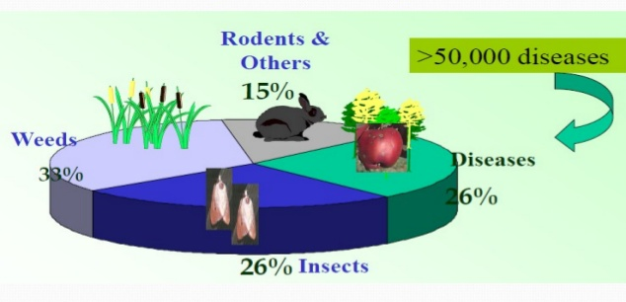
% Loss in Yield Due to Diseases
Plant disease reduces the production and quality of food, fibre and biofuel crops, like sugarcane, oilseed, etc.
On average, plant diseases account for 42% reduction in yield of the most important food/cash crops like Sugarcane , Potatoes , maize,etc .
Annual Monetary Loss in India only was 60,000 Cr in the year 2015-16.
Overview of Loss in Yield due to diseases

Slide 5
Impact of Early detection of Diseases in Plants
Potatoes and Tomatoes are much more prone to fungal diseases. If not dealt at initial stages , these fungi can turn a healthy green field into a field full of yellow and brown leaves within weeks.
These diseases looks so similar to human eye that it becomes very difficult for a novice farmer to identify the disease correctly.
Each year, plant viruses and fungal attacks lead to crop losses of up to 30 percent in case of potatoes.
Testing the samples of plants becomes a time taking pocess.
If these diseases are detected at early stages, it saves fertilizer quantity , reduces treatment duration , thus finally saving time, cost and labour. Meanwhile also preserving the quantity and quality of the yield.

Slide 6
Introduction to Idea
Most of the farmers treat the infected plants either based on their own past experience and knowledge, while only a few have agricultural test centers available nearby them.
So we have train our model with the images of the infected leaves (seggregated class/disease wise), and we are able to predict that the disease class from the picture of leaf from a random plant with an accuracy of 92%.
We have taken our dataset from Kaggle, which has images of Potato, Tomato and pepper plant with each plant having seperate classes for seperate diseases.
Further , if we integrate our model using API(fastAPI, Flask,etc) with a mobile app, a user can click the image of a leaf and the app will display the disease name to the user within seconds.

Slide 7
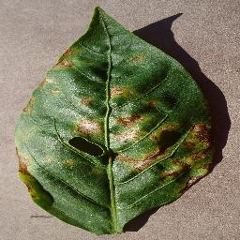
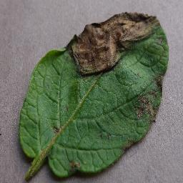
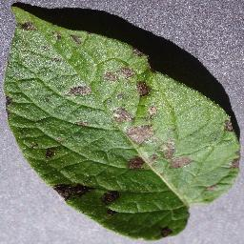
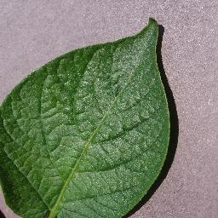
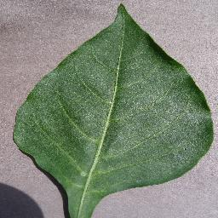
TESTING DATASET - Brief Introduction
In our Dataset , we have 15 different folders containing images of Potatoes,Tomatoes and Pepper.We will look across a total number of 12 diseases among these 3 plants , while 3 folders contains healthy leaf images of each plant.
Below is a description of what each folders repesent means in our dataset:
Pepper Bell Bacterial Spot
Potato Late Blight
Potato Early Blight
Pepper Bell Healthy
Potato Healthy

Slide 8
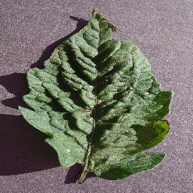
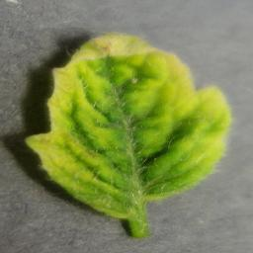
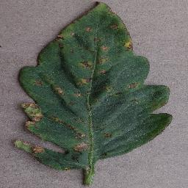
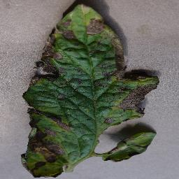
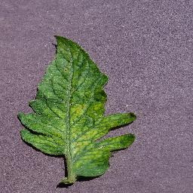
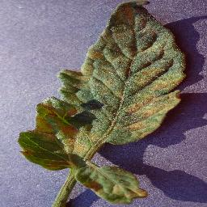
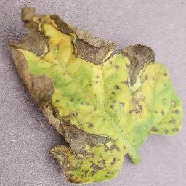
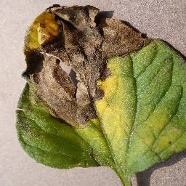
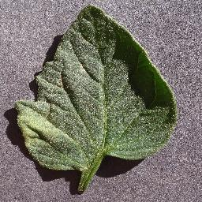
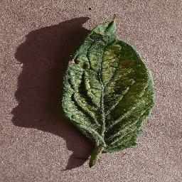
Diseases in Tomatoes
Target Spot
Yellow Leaf-Curl Virus
Bacterial Spot
Early Blight
Mosaic Virus
Mold
Septoria Leaf Spot
Late Blight
Various Types of
diseases in tomatoes
which our model can
detect.
Tomato Healthy
Spider Mites

Slide 9
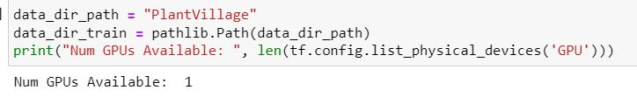
Set Up For Development Environment Working With GPU
GPU (graphics processing unit) is a specialized processing unit with enhanced mathematical computation capability, ideal for computer graphics and machine-learning tasks.
GPU is 4-5 times faster than CPU. This value is more enhanced by using prefetching and caching while training our data.
We install CUDA and CUDNN packages from NVIDIA to be able to use GPU on our device.
System Requirments : NVIDIA Graphics card

Slide 10
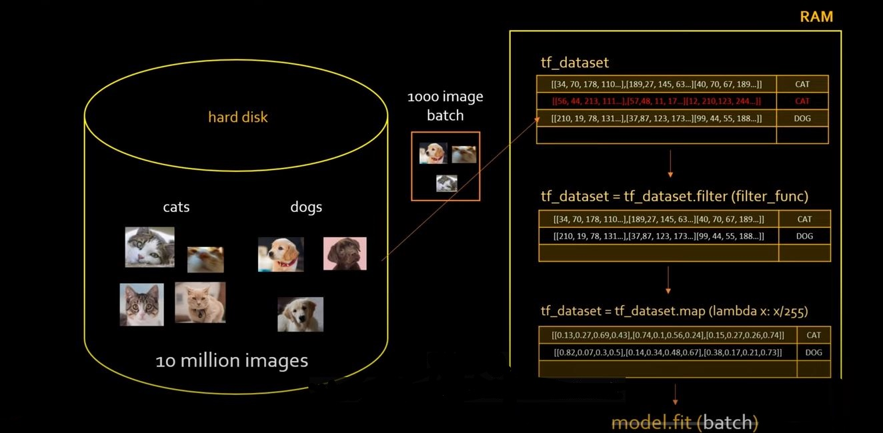
DATA PREPROCESSING
ETL(Extract, Transform And Load) :
We have used tf.data module to extract data from hard disk
Since the number of images is very high , we use the streaming approach of Tensorflow Data Input Pipeline, i.e. we load the images in multiple batches having a fixed number of images each.

Slide 11
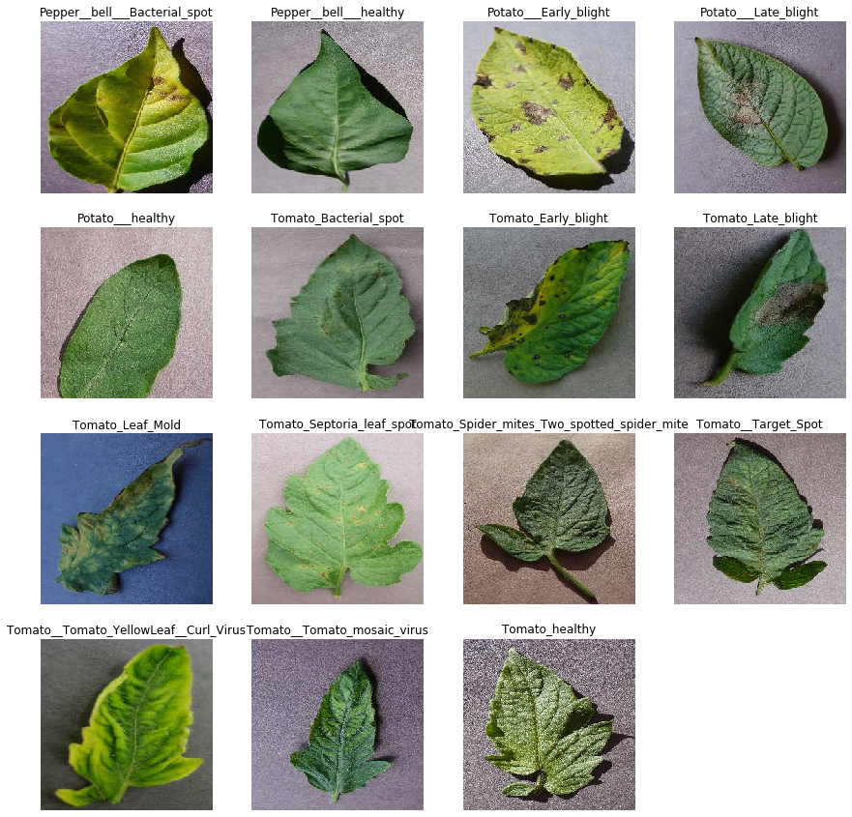
DATA VISUALIZATION

Slide 12
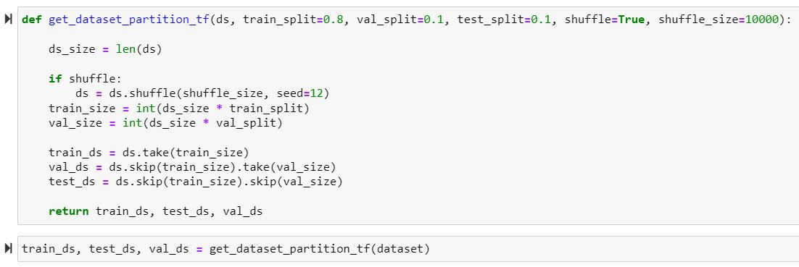
TRAIN TEST SPLIT
In sklearn we have train_test_split to to split data for trainig and testing. In tensorflow ,we will have to use dataset.take() to split the data into training(80%) , testing (10%) and validation(10%) datasets.
By passing the parameters , we can also adjust our Train-test dataset split percentages .

Slide 13
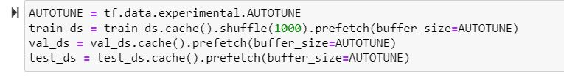
OPTIMIZING THE PERFORMANCE OF OUR DATA INPUT PIPELINE
1. PREFECTHING : It prefetches the next batch in CPU , while GPU is still busy in trainig the previously fetched batch.
Thus , while running multiple epochs , GPU is never idle and it enhances the computational speed significantly.
AUTOTUNE: It allows tensorflow to decide on its own that how many batches to prefetch while GPU training.

Slide 14
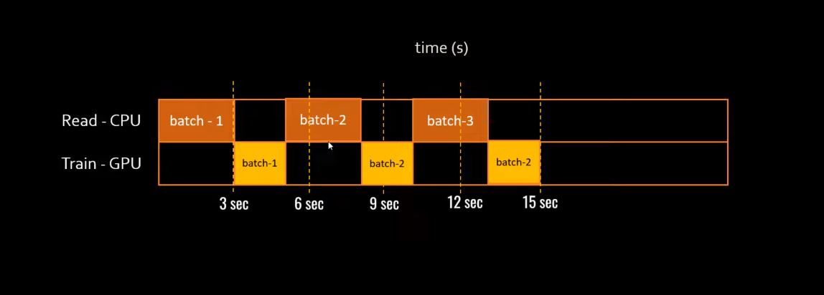
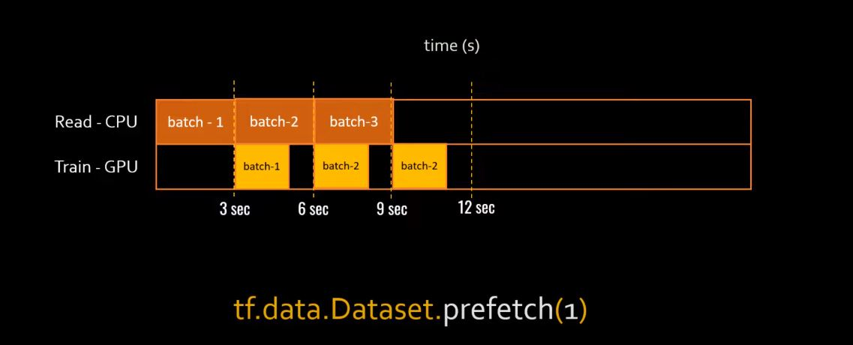
CPU-GPU Chart without Prefetch
CPU-GPU Chart with Prefetch

Slide 15
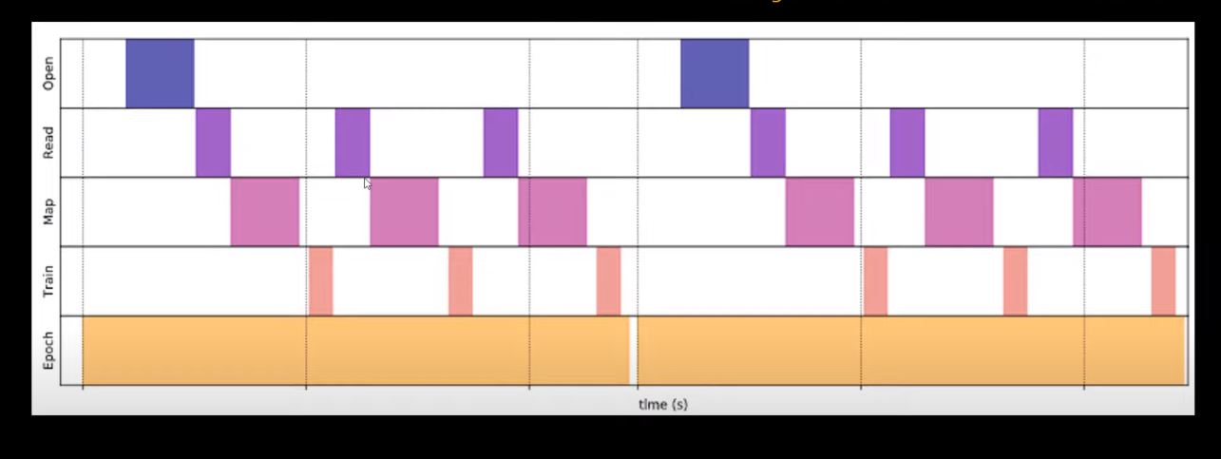
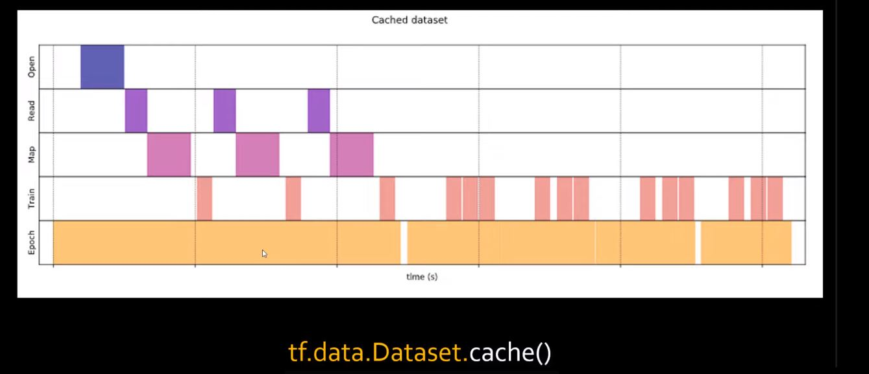
CACHING
When images are read from disk in first iteration,we keep these images ready for next iteration to save time.

Slide 16
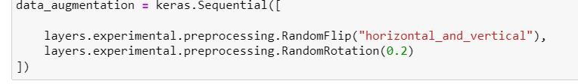
DATA AUGMENTATION
CNN is not rotation or scale invariant.(i.e. if we rotate or rescale the images, the efficiency of the model will depreciate.
To handle this, we use Data Augmentation.
Fom existing training samples , we generate new samples after applying several transformations like Horizontal flip, contrast, rotation, zoom, etc. to generate new training samples.
This increases the accuracy of the model significantly.
We have resized and rescaled the images to achieve data normalization to avoid any outliers.
This is done to address the problem of overfitting in the model

Slide 17
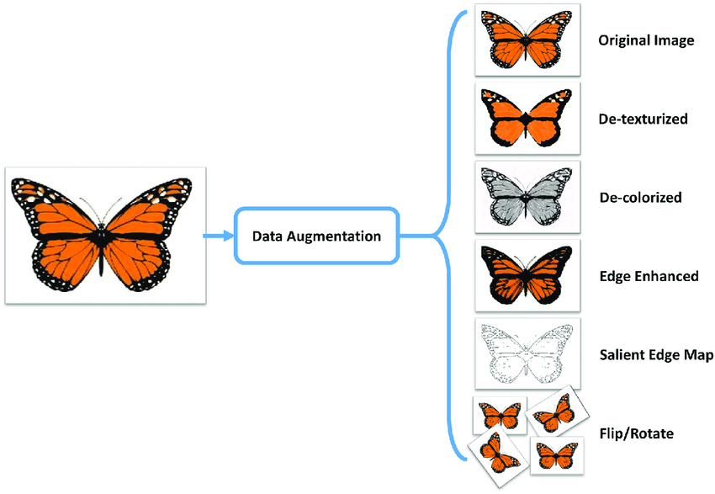
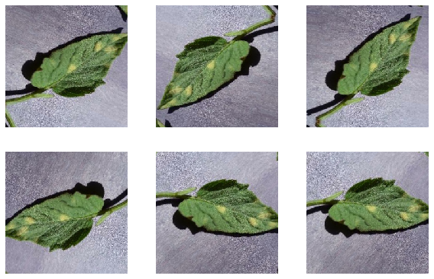
Augmented image of a tomato leaf with multiple rotations

Slide 18
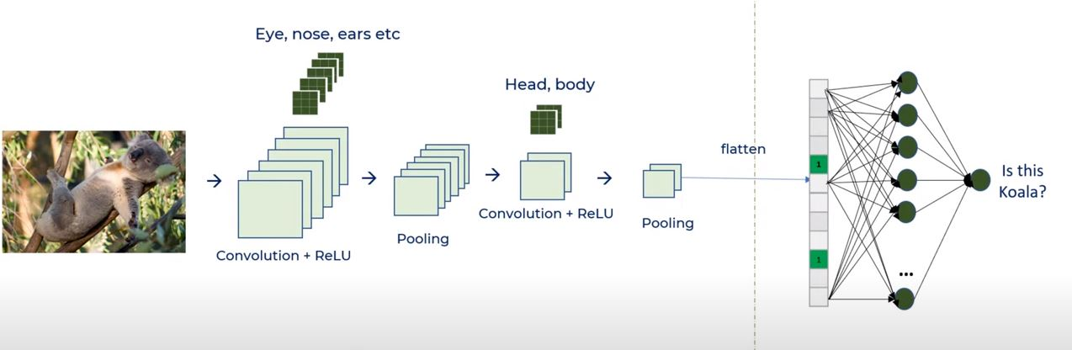
USING CNN FOR IMAGE DETECTION
We use multiple Convolution +ReLu layers followed by pooling to build our model

Slide 19

POOLING
Reduces dimensions and computation
Reduces overfitting as there are less parameters
Model becomes much tolerant towards variations as we use average or max value , so noise is filtered.
The Convolutional Layer and the Pooling Layer, together form the i-th layer of a Convolutional Neural Network. Depending on the complexities in the images, the number of such layers may be increased for capturing low-levels details even further, but at the cost of more computational power.We have used max pooling in our model
Max Pooling also performs as a Noise Suppressant.

Slide 20
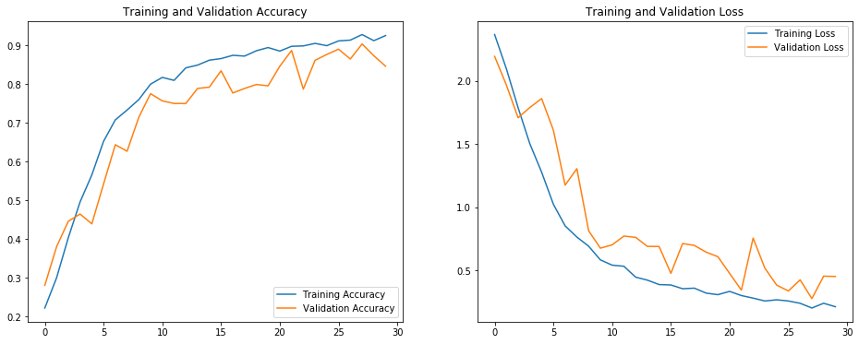
TRAIN RESULTS : VISUALIZATIONS

Slide 21
RESULT
Our model was able to predict the disease in a given leaf with an accuracy if 92.54%.
Currently we trained our model for Potatoes , Tomatoes and Pepper only. Further, it can expand to all crops which are much prone to diseases and which shows significant changes in their appearances when hit by diseases.

Slide 22
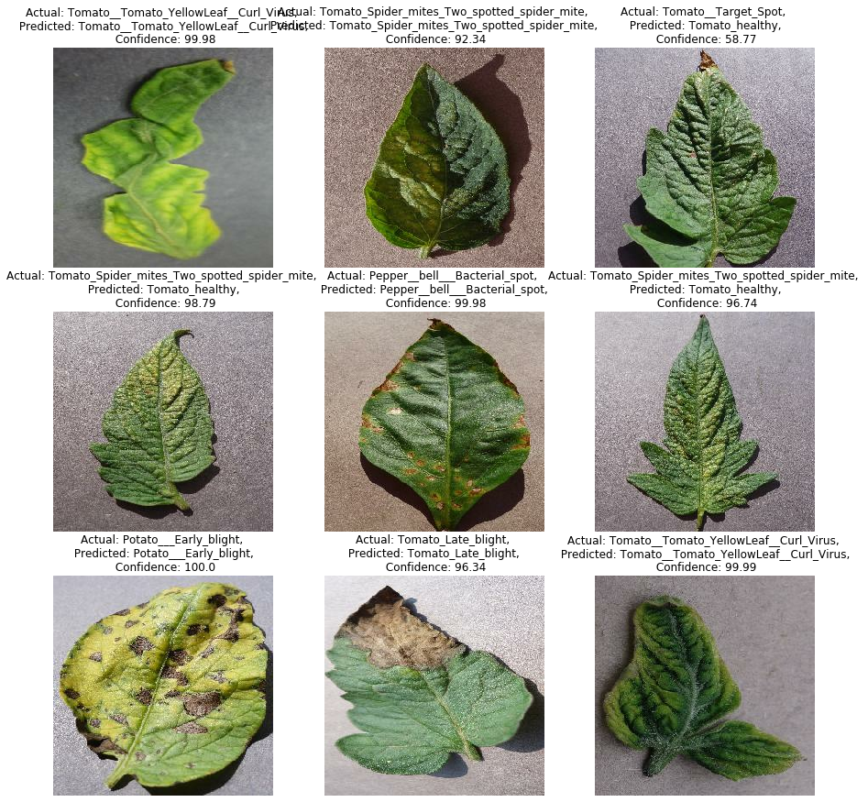

Slide 23
FUTURE SCOPE
This would help the farmers and other agricultural agencies to detect diseases in plants at early stages, and minimize the economic loss faced by farmers due to poor crop yield.
Futhermore, the model can also be integrated to provide disease specific and personalised probable treatments,supplements and precautions for plants sufferring from any diseases.
Converted into form of a mobile app, any farmer with a phone having camera in it can click the picture of the leaf of the crop and check whether their crop is growing healthy or showing any symptoms of diseases.

Slide 24
Future Scope
Plant disease Prediction
Built a model which can work in succesful and quick predicition of diseases in plants with help of CNN
Kisan Mitra App
An android application in which farmers will have to open the app- click picture of their crop - and they will get the prediction from the app and probable precautions and required supplements.
Kisan Mitra Web App
A web application which can help all the farmers across the globe to upload a picture of their crop and check out for crop’s health,diseases , probable supplements etc.

Slide 25
CONCLUSION
The topic for our major project is Plant disease prediction using image classification using Convolutional Neuran Network. The accuracy of our model after 30 epochs isis 92.54%. In this model we used GPU ( From NVIDIA-CUDA) and built tf_data pipeline usinf tensorflow to make out computations 10-12 times faster. We have used techniques like prefetching and caching to reduce model training time and resizing and rescaling to remove outliers(Data Normalization).
As Number of Epochs increases our model’s accuracy increases.
Through the developed model, we predicted that whether the given image has any disease or is healthy, with an accuracy of 92.54%.

Slide 26
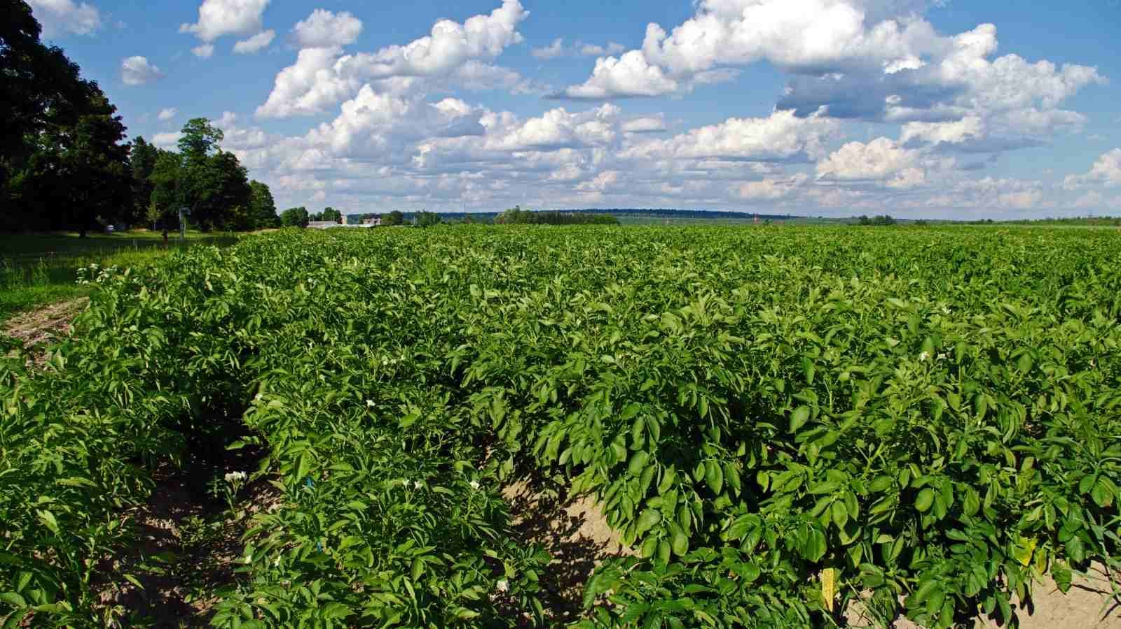
THANK
YOU

Slide 27


REFRENCES
https://devdocs.io/numpy~1.14/
https://who.org.in/
https://pandas.pydata.org/pandas-docs/version/0.15/tutorials.html
https://python-graph-gallery.com/seaborn/
https://www.tutorialspoint.com/seaborn/index.htm
https://ourworldindata.org/api/index.html
https://en.wikipedia.org/wiki/Python_Imaging_Library
https://scikit-learn.org/stable/documentation.html
https://docs.python.org/3/library/sys.html
https://scikit-learn.org/dev/_downloads/scikit-learn-docs.pdf

